Slide 1
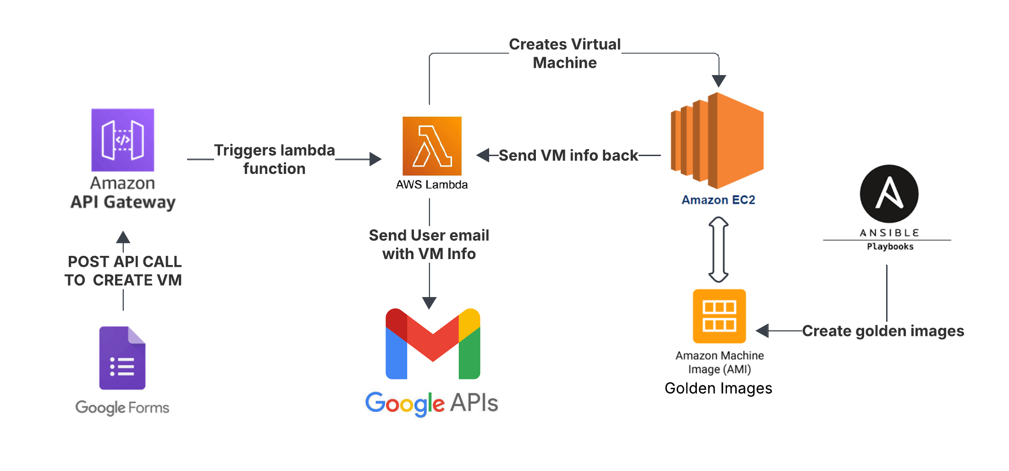
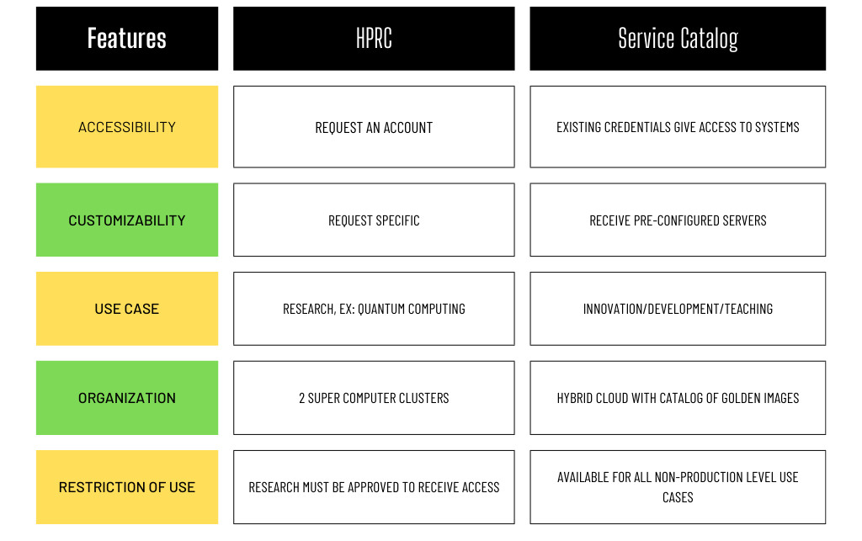



25-329
Virginia Commonwealth University
Service Catalog
Team members: Akhil Manoj, Nick Arthur, Sage Walker, Bilal Othman | Faculty adviser: Ahmet Sonmez, Ph.D. | Sponsor: Virginia Commonwealth University | Mentor: Robert Dahlberg, Ph.D
Problem Statement
Illustrations
Solution
Virginia Commonwealth University faces challenges in efficiently providing access to computing resources, including:
Development Environments
Virtual Infrastructure
Sharable computing resources
Professors need to provision servers and containers for their students
Students need a catalog of servers and containers from which they can choose from
Provisioning instances from the catalog should not require a lot of technical skill – must be easy
Identify server types necessary for the service catalog:
AI & Natural Language Processing servers
Application servers
Database servers
Development environments
Virtual Reality & Augmented Reality servers
Web servers
Identify the software that needs to be installed for each server and the hardware configuration needed
Create a “golden image” for each server that users can easily deploy and customize within AWS Cloud
Utilize Ansible for provisioning of each server
Existing Solutions
Methodology
High Performance Resource Computing
Heavily Restricted
Requires Approval
Utilize Amazon Web Services for providing the infrastructure and networking
Utilize Ansible for provisioning an instance of a “golden image” virtual server
Utilize Google API to send credentials for the virtual servers to users
Social Value
The Service Catalog provides a hybrid cloud development platform in which to students and faculty can collaborate.
The Service Catalog provides computer resources for teaching, research and collaborative development between industry, government and education
Next Steps
Integrate “golden images” into the service catalog
Integrate the Ansible playbooks to the client dashboard to allow clients to provision their own instances from the service catalog

